Slide 1
Lesson 12 - Intro to Grids
Mr Mack 2019

Slide 2
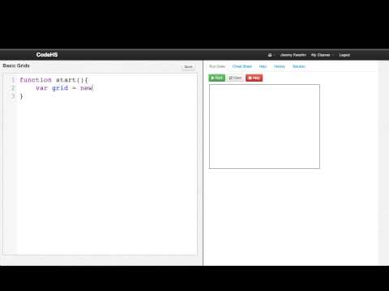
Intro to Grids

Slide 3
What is a Grid?
A collection of items each stored at a specific (row, column) location
A collection of unique items with no particular order
A function
A type of 2 dimensional image

Slide 4

What is the result of calling grid.numRows()?
2
3
4
5

Slide 5

What is the result of calling grid.get(2, 1)?
11
2
7
5

Slide 6
Example: Grid Basics
This is an example for this lesson. You are encouraged to play around with it, run and change the code, and learn how it works. When you are done, click continue to go to the next problem.

